Slide 1
Complex Decisions
Chapter 17

Slide 2
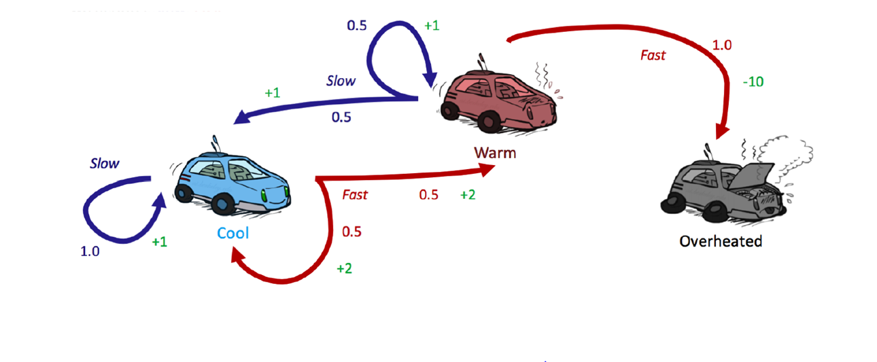

States={cool, warm, overheated}
Actions={fast, slow}
γ=0.5
Initially: U₀(cool)=0, U₀(warm)=0, U₀(overheated)=0
Run two iterations of the value iteration algorithm.
Notes:
U_{t+1}(cool) = max(
P(cool | cool, slow) * (R(cool, slow, cool) + γ U_{t}(cool)),
P(cool | cool, fast) * (R(cool, fast, cool) + γ U_{t}(cool)) + P(warm | cool, fast) * (R(cool, fast, warm) + γ U_{t}(warm)
) = max( 1 * (1 + 0.5U_{t}(cool)), 0.5 * (2 + 0.5U_{t}(cool)) + 0.5 * (2 + 0.5U_{t}(warm))) = max( 1 + 0.5U_{t}(cool), 2 + 0.25U_{t}(cool) + 0.25U_{t}(warm))
U_{t+1}(warm) = max(
P(cool | warm, slow) * (R(warm, slow, cool) + γ U_{t}(cool)) + P(warm | warm, slow) * (R(warm, slow, warm) + γ U_{t}(warm),
P(overheated | warm, slow) * (R(warm, slow, overheated) + γ U_{t}(overheated))
) = max(0.5 * (1 + 0.5U_{t}(cool)) + 0.5 * (1 + 0.5U_{t}(warm)), 1* (-10 + 0.5U_{t}(overheated))) = max(1 + 0.25U_{t}(cool) + 0.25U_{t}(warm), -10 + 0.5U_{t}(overheated))
U_{t+1}(overheated) = 0
Iteration 1:
U₁(cool) = max(1 + 0.5U₀(cool), 2 + 0.25U₀(cool) + 0.25U₀(warm)) = max(1 + 0.5*0, 2 + 0.25*0 + 0.25*0) = max(1, 2) = 2
U₁(warm) = max(1 + 0.25U₀(cool) + 0.25U₀(warm), -10 + 0.5U₀(overheated)) = max(1 + 0.25* + 0.25*0, -10 + 0.5*0) = max(1, -10) = 1
U₁(overheated) = 0
Iteration 2:
U₂(cool) = max(1 + 0.5U₁(cool), 2 + 0.25U₁(cool) + 0.25U₁(warm)) = max(1 + 0.5*2, 2 + 0.25*2 + 0.25*1) = max(2, 2.75) = 2.75
U₂(warm) = max(1 + 0.25U₁(cool) + 0.25U₁(warm), -10 + 0.5U₁(overheated)) = max(1 + 0.25*2 + 0.25*1, -10 + 0.5*0) = max(1.75, -10) = 1.75
U₂(overheated) = 0
Policy extraction:
π(cool) = argmax(slow: 1 + 0.5U₁(cool), fast: 2 + 0.25U₁(cool) + 0.25U₁(warm)) = argmax(slow: 1 + 0.5*2.75, fast 2 + 0.25*2.75 + 0.25*1.75) = argmax(slow: 2.375, fast: 3.125) = fast
π(warm) = argmax(slow: 1 + 0.25U₁(cool) + 0.25U₁(warm), fast: -10 + 0.5U₁(overheated)) = argmax(slow: 1 + 0.25*2.75 + 0.25*1.75, fast: -10 + 0.5*0) = argmax(slow: 2.125, fast: -10) = slow

Slide 3

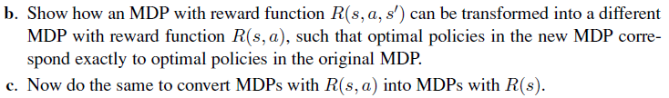

Slide 4


Notes:
a. The key here is to get the max and summation in the right place.
For R(s), we use the first formula above
For R(s, a), we use the second formula above
For R(s, a, s′), we use the third formula above.
b. There are a variety of solutions here. One is to create a “pre-state” pre(s, a, s′) for every s, a, s′, such that executing a in s leads not to s′ but to pre(s, a, s′). In this state is encoded the fact that the agent came from s and did a to get here. From the pre-state, there is just one action b that always leads to s′. Let the new MDP have transition P′, reward R′, and discount γ′. Then
P′(pre(s, a, s′) | s, a) = P(s′ | s, a)
P′(s′ | pre(s, a, s′), b) = 1
R′(s, a) = 0
R′(pre(s, a, s′), b) = R(s, a, s′) / sqrt(γ)
γ′ = sqrt(γ)
c. In keeping with the idea of part (b), we can create states post(s, a) for every s, a, such that
P′(post(s, a, s′) | s, a) = 1
P′(s′ | post(s, a, s′), b) = P(s′ | s, a)
R′(s) = 0
R′(post(s, a, s′)) = R(s, a) / sqrt(γ)
γ′ = sqrt(γ)

Slide 5
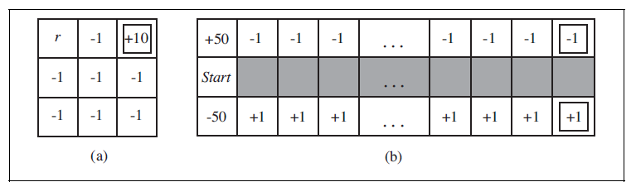
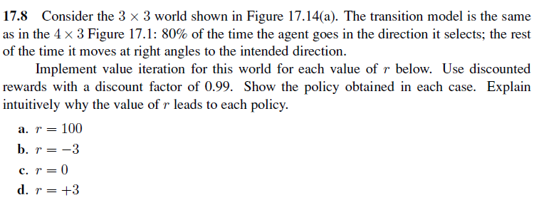
Instead of actually implementing value iteration, try to predict the policy by intuition
Notes:
a.
LL_
ULD
ULL
Instead of seeking the goal, the agent would prefer to go the r=100 cell. Since the discount factor is high, the agent wouldn’t mind paying some losses to reach a larger reward later on. So the agent will avoid the terminal cell (+10) and will do whatever it can to reach the +100 cell. At the cell below the +10, it would take the action “Down” to avoid entering the terminal cell by accident. At the cells in the middle column, it will alway pick “Left” to make sure it never goes right by accident.
At some cells, there are multiple optimal actions. For example, at the “+100” cell, it can pick “Up” or “Left” and the utility shouldn’t differ.
b.
RR_
RRU
RRU
The agent will try to avoid the “-3” cell and try to reach the terminal state “+10” as soon as possible.
c.
RR_
UUU
UUU
The agent will try to reach the terminal state “+10” as soon as possible and it will prefer the path going through the “0”-reward cell (if there is no other path that is shorter).
d.
LL_
ULD
ULL
This is similar to the first one. It may seem surprising that the agent will prefer the “+3” cell over the terminal “+10” cell but remember that the “+3” cell is not a terminal state. Thus the agent can keep getting rewards from it as long as it stays on it. So the agent can gain much more rewards by staying on the “+3” cell as long as possible than what it would get from reach the “+10” state which would return +10 once then end the episode. This is only true because the discount factor is high. If it was low, the agent would prefer getting the “+10” early than waiting to get multiple “+3”s in the future.

Slide 6
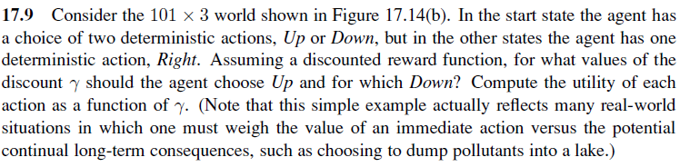
Notes:
U((1,1)) = -50 + γ¹ + γ² + γ³ + .. + γ¹⁰⁰ = -50 + γ(1 - γ¹⁰⁰)/(1 - γ)
U((1,3)) = 50 - γ¹ - γ² - γ³ - .. - γ¹⁰⁰ = 50 - γ(1 - γ¹⁰⁰)/(1 - γ)
To choose up, it must be U((1,1)) < U((1,3))
-50 + γ(1 - γ¹⁰⁰)/(1 - γ) < 50 - γ(1 - γ¹⁰⁰)/(1 - γ)
2γ(1 - γ¹⁰⁰)/(1 - γ) < 2(50)
γ(1 - γ¹⁰⁰) < 50(1 - γ) since 1 - γ > 0
This can be solved using numerical methods.
γ < 0.9843976692
So if γ < 0.9843976692, we choose up
Otherwise, we choose down

Slide 7
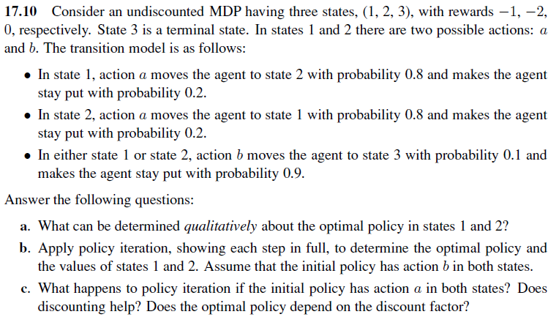
Extra: Apply value iteration for 3 iterations then extract the policy.
Notes:
a. The policy should be (b, a, _)
Because, the agent will try reach the terminal state (state 3) as soon as possible to stop getting penalties from being in state 1 or 2.
The only action to reach state 3 is “b” which only has a probability of 0.1 to actually move the agent to state 3. So the agent should prefer to go to state 1 first since it has a lower penalty then try to go to state 3 from there. Therefore, the action to pick in state 2 is “a” while the action to pick in state 1 is “b”.
b. Since π(1) = b and π(2) = b, the values for this policy can be computed from using the following equation:
U(1) = -1 + 0.1*U(3) + 0.9*U(1)
U(2) = -2 + 0.1*U(3) + 0.9*U(2)
U(3) = 0
By solving this equation, we get U(1) = -10, U(2) = -20, U(3) = 0
Now, we compute the new policy
π(1) = argmax(a: 0.8*U(2)+0.2*U(1), b: 0.1*U(3) + 0.9*U(1)) = argmax(a: 0.8*-20+0.2*-10, b: 0.1*0 + 0.9*-10) = argmax(a: -18, b: -9) = b
π(2) = argmax(a: 0.8*U(1)+0.2*U(2), b: 0.1*U(3) + 0.9*U(2)) = argmax(a: 0.8*-10+0.2*-20, b: 0.1*0 + 0.9*-20) = argmax(a: -12, b: -18) = a
Then we get the new equations:
U(1) = -1 + 0.1*U(3) + 0.9*U(1)
U(2) = -2 + 0.8*U(1) + 0.2*U(2)
U(3) = 0
So U(1) = -10, U(2) = -12.5, U(3) = 0
Now, we compute the new policy
π(1) = argmax(a: 0.8*U(2)+0.2*U(1), b: 0.1*U(3) + 0.9*U(1)) = argmax(a: 0.8*-12.5+0.2*-10, b: 0.1*0 + 0.9*-10) = argmax(a: -12, b: -9) = b
π(2) = argmax(a: 0.8*U(1)+0.2*U(2), b: 0.1*U(3) + 0.9*U(2)) = argmax(a: 0.8*-10+0.2*-12.5, b: 0.1*0 + 0.9*-12.5) = argmax(a: -10.5, b: -11.25) = a
Since the policy did not change from the last iteration, we stop now.
The optimal policy is (b, a, _).
c. Since π(1) = a and π(2) = a, the values for this policy can be computed from using the following equation:
U(1) = -1 + 0.8*U(2) + 0.2*U(1)
U(2) = -2 + 0.8*U(1) + 0.2*U(2)
U(3) = 0
These equations has no solution.
If we add a discount factor γ, the equations will become
U(1) = -1 + γ(0.8*U(2) + 0.2*U(1))
U(2) = -2 + γ(0.8*U(1) + 0.2*U(2))
U(3) = 0
Which are solvable if γ < 1
And yes, the optimal policy depends on the discount factor.
Extra:
Assume that initially, U(1)=U(2)=U(3)=0
Iteration 1:
U(1) = -1 + max(0.8*U(2)+0.2*U(1), 0.1*U(3) + 0.9*U(1)) = -1 + max(0.8*0+0.2*0, 0.1*0 + 0.9*0) = -1 + max(0, 0) = -1 + 0 = -1
U(2) = -2 + max(0.8*U(1)+0.2*U(2), 0.1*U(3) + 0.9*U(2)) = -2 + max(0.8*0+0.2*0, 0.1*0 + 0.9*0) = -2 + max(0, 0) = -2 + 0 = -2
U(3) = 0
Iteration 2:
U(1) = -1 + max(0.8*U(2)+0.2*U(1), 0.1*U(3) + 0.9*U(1)) = -1 + max(0.8*-2+0.2*-1, 0.1*0 + 0.9*-1) = -1 + max(-1.8, -0.9) = -1 + -0.9 = -1.9
U(2) = -2 + max(0.8*U(1)+0.2*U(2), 0.1*U(3) + 0.9*U(2)) = -2 + max(0.8*-1+0.2*-2, 0.1*0 + 0.9*-2) = -2 + max(-1.2, -1.8) = -2 + -1.2 = -3.2
U(3) = 0
Iteration 3:
U(1) = -1 + max(0.8*U(2)+0.2*U(1), 0.1*U(3) + 0.9*U(1)) = -1 + max(0.8*-3.2+0.2*-1.9, 0.1*0 + 0.9*-1.9) = -1 + max(-2.94, -1.71) = -1 + -1.71 = -2.71
U(2) = -2 + max(0.8*U(1)+0.2*U(2), 0.1*U(3) + 0.9*U(2)) = -2 + max(0.8*-1.9+0.2*-3.2, 0.1*0 + 0.9*-3.2) = -2 + max(-2.16, -2.38) = -2 + -2.16 = -4.16
U(3) = 0
Now we extract the policy:
π(1) = argmax(a: 0.8*U(2)+0.2*U(1), b: 0.1*U(3) + 0.9*U(1)) = argmax(a: 0.8*-4.16+0.2*-2.71, b: 0.1*0 + 0.9*-2.71) = argmax(a: -3.37, b: -2.439) = b
π(2) = argmax(a: 0.8*U(1)+0.2*U(2), b: 0.1*U(3) + 0.9*U(2)) = argmax(a: 0.8*-2.71+0.2*-4.16, b: 0.1*0 + 0.9*-4.16) = argmax(a: -3, b: -3.744) = a

